Slide 1
Tools of the Trade

Slide 2
Phase One: VM or Machine Setup

Slide 3
Basics: Hardware and Software
Hardware:
The computer you already have
Raspberry Pi (2-4)
Older/Used laptops (Thinkpads are what I would recommend)
The VM Route: https://bit.ly/2Ekfn0Z (Workshop 1 notes)
Kali Documentation: https://www.kali.org/docs/
Parrot Documentation: https://docs.parrotlinux.org/
Dual-Boot Route: https://bit.ly/2M1tz35
**I personally recommend dual booting if at all possible possible**

Slide 4
Hardware and Software Cont.
Docker??
https://bit.ly/36Kev1R
AWS??
https://bit.ly/2r1wwcI
Server??
Used hardware on eBay
ESXI hypervisor

Slide 5
Phase Two: Personal Security

Slide 6
Best Practices
Password Manager
1Password
LastPass
Remembear
2FA
Yubikey: https://amzn.to/36EPRzn
Google Titan: http://bit.ly/2YVmAOc
Biometric (If available)
6-digit code generator
Internet Traffic Security
PiVPN/OpenVPN
PiHole
AnonSurf (Installed by default on Parrot)

Slide 7
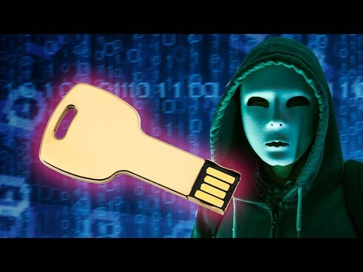
Yubikey

Slide 8
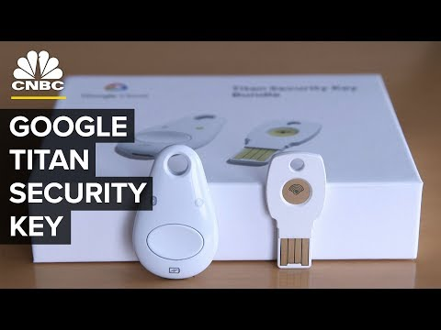
Google Titan

Slide 9
Part Three: The Fun Stuff

Slide 10
Physical Access
Physical Access:
Lock Picks: http://bit.ly/2Eq3Xsl (Sets are located at the end of the slides)

Slide 11


Slide 12
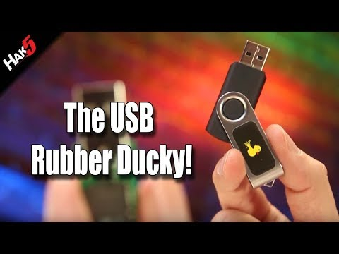
Social Engineering/Physical Access: USB Rubber Ducky

Slide 13
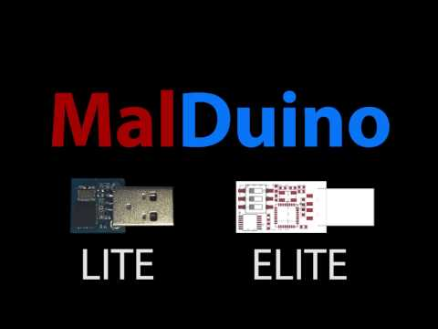
Social Engineering/Physical Access: MalDuino

Slide 14
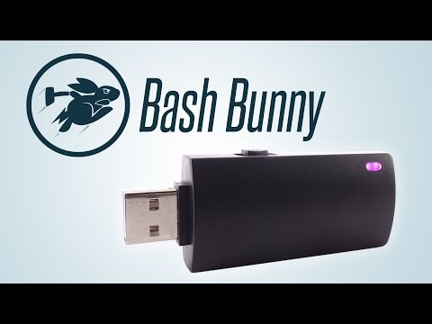
Social Engineering/Enumeration/Physical Access: Bash Bunny

Slide 15
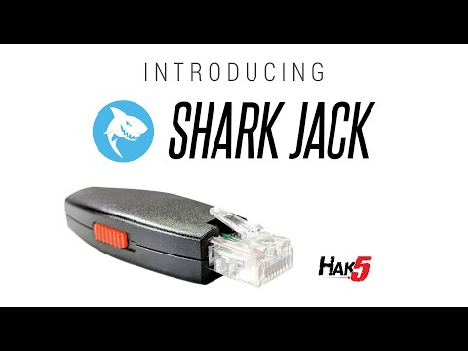
Enumeration: Shark Jack

Slide 16
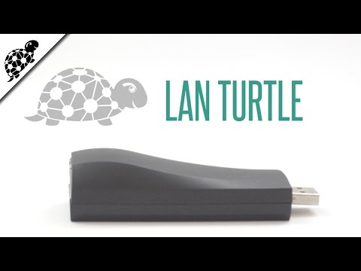
Network Implant: LAN Turtle

Slide 17
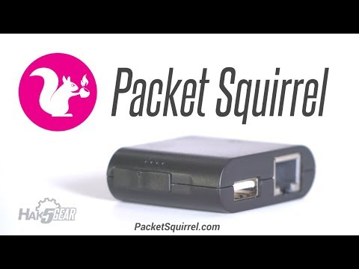
Network Implant/Man-in-the-middle: Packet Squirrel(/Plunder Bug)

Slide 18

Wifi Man-in-the-Middle: WiFi Pineapple (nano)

Slide 19

Wireless Testing: Signal Owl

Slide 20
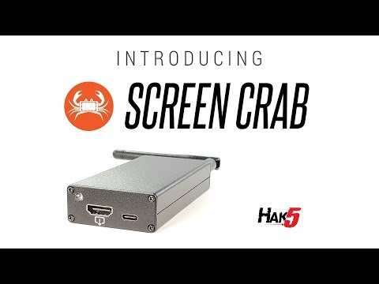
Network/Device Implant: Screen Crab

Slide 21
Lock Picks
Sparrows: https://www.sparrowslockpicks.com/
Entry: Kick Start ($20.00)
Mid: Tuxedo ($32.00)/EOD Light ($37.00)/EOD Full ($53.00)
Money is no object: Vorax ($95.00)
Non-Sparrows: https://amzn.to/2RTciwS

Slide 22
Hacking Stuff
hak5.org

